Slide 1
Accessing and Using the Alma Link Resolver from Outside Primo
Yoel Kortick
Senior Librarian
Alma Product Management

Slide 2
Copyright Statement
All of the information and material inclusive of text, images, logos, product names is either the property of, or used with permission by Ex Libris Ltd. The information may not be distributed, modified, displayed, reproduced – in whole or in part – without the prior written permission of Ex Libris Ltd.
TRADEMARKS
Ex Libris, the Ex Libris logo, Aleph, Alma, SFX, SFXIT, MetaLib, DigiTool, Verde, Primo, Voyager, MetaSearch, MetaIndex and other Ex Libris products and services referenced herein are trademarks of Ex Libris, and may be registered in certain jurisdictions. All other product names, company names, marks and logos referenced may be trademarks of their respective owners.
DISCLAIMER
The information contained in this document is compiled from various sources and provided on an "AS IS" basis for general information purposes only without any representations, conditions or warranties whether express or implied, including any implied warranties of satisfactory quality, completeness, accuracy or fitness for a particular purpose.
Ex Libris, its subsidiaries and related corporations ("Ex Libris Group") disclaim any and all liability for all use of this information, including losses, damages, claims or expenses any person may incur as a result of the use of this information, even if advised of the possibility of such loss or damage.
© Ex Libris Ltd., 2011

Slide 3
Agenda
Why do we need the Alma Link resolver
Introduction and overview
Example
Behind the scenes
Summary

Slide 4
Why do we need the Alma Link Resolver
Many users begin their search not from the library catalog such as Primo but rather from another source
  In this case Alma is being used even if user searches in another database - not necessarily Primo
  For example user may search PubMed, Web of Science, American Physiological Association, etc.
The Alma Link resolver, via Primo, provides services for the patron for both print and electronic material.
Need Alma Link resolver so patron can access material that library either owns physically or has a subscription for

Slide 5
Agenda
Why do we need the Alma Link resolver
Introduction and overview
Example
Behind the scenes
Summary

Slide 6
Introduction and overview
The following process is used by Alma to display services to end users:
An end user performs a search in a source (such as PubMed) and requests services.
The source sends an open URL request to Primo.
Primo forwards it to Alma.
Alma process the open URL and returns the following to Primo:
  Metadata
  An indication if there are
    ViewIt (electronic services)
    GetIt (physical services)
    Both ViewIt and GetIt
As a result Primo generates the services page

Slide 7




Introduction and overview
2.
3.
The source sends a request for services (open URL) to Primo
Primo modifies the request for services and send to Alma
4.
Primo displays Services Page in browser of end user
Alma sends response back to Primo
5.
1.
User searches a source and requests services
Finish
Start
http://lorealprofessionnel.co.uk/blog/wp-content/uploads/2012/03/THE-SOURCE-LOGO5.png
http://www.aiche.org/sites/default/files/event/lead_image/global_career-professional-woman-online-computer-career-istk_0_1_1.jpg

Slide 8
Introduction and overview
As a link resolver, Alma provides services for searches performed in sources other than Alma
Alma’s link resolver uses the Services Page view (which is defined in Primo) in order to display these services.
This view is based on the standard Primo view.
See also Alma OLH: Configuring the Primo Front End for Alma’s Link Resolver > Introduction

Slide 9
Agenda
Why do we need the Alma Link resolver
Introduction and overview
Example
Behind the scenes
Summary

Slide 10
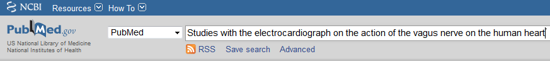
Example
While logged into the National Center for Biotechnology Information the user searches PubMed for article “Studies with the electrocardiograph on the action of the vagus nerve on the human heart: II” (PMID: 19867504)

Slide 11
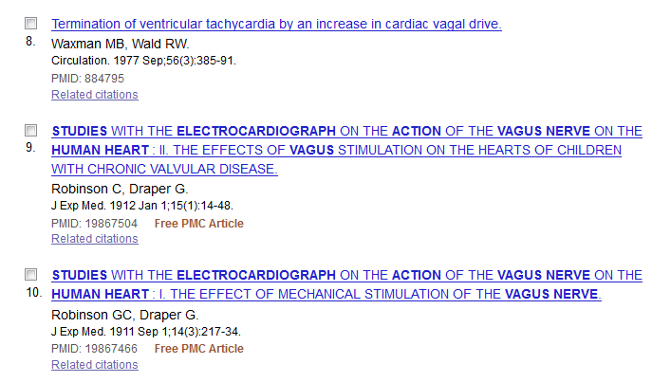
Example
The user clicks the desired article

Slide 12
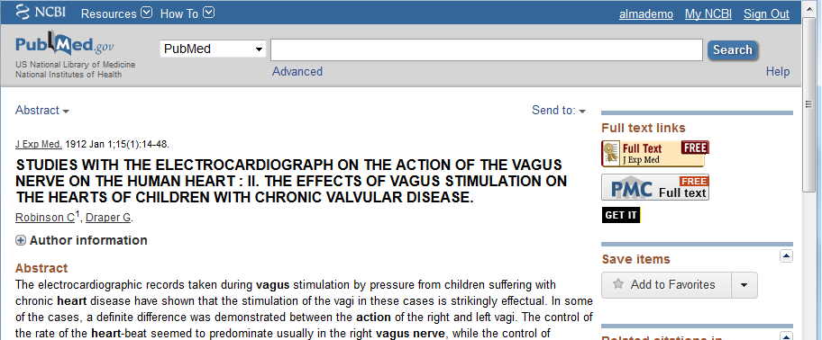
Example
From the results the user clicks the relevant link to access the record.
Here the link is called GET IT but the library or provider will change it as desired
Step 1 User searches a source and requests services

Slide 13
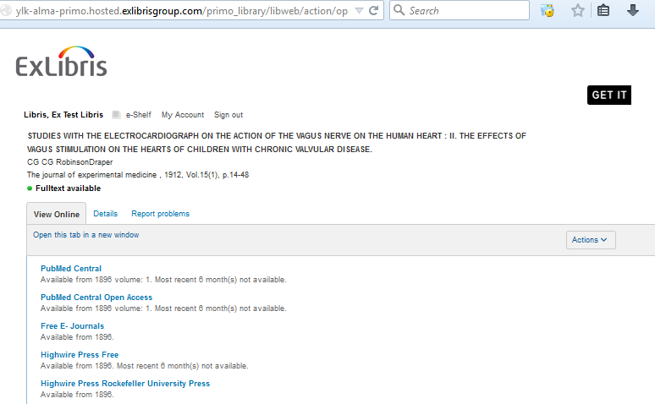
Example
Primo returns the services page
This is the service page and we can see that it is from Primo
This part of the services page is built according what Alma sent on step 4 of slide 6
Login of user
This part of the services page is a mash-up from Alma
Step 5 Primo displays Services Page in browser of end user

Slide 14
Example
Primo returns the services page
And now if we click one of these links …
Step 5 Primo displays Services Page in browser of end user

Slide 15
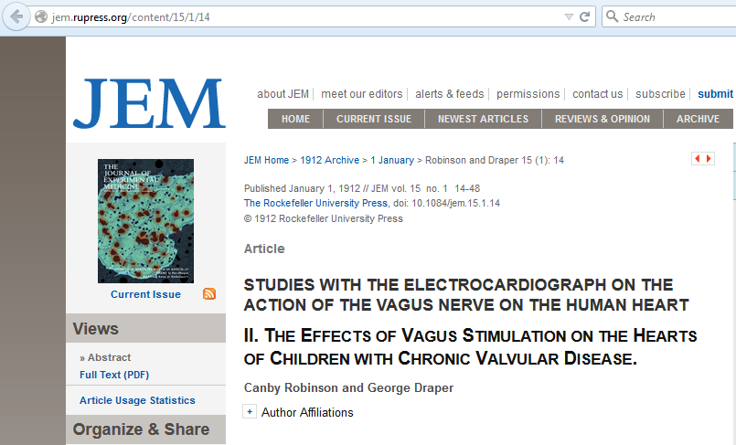
Example
We arrive to the article
This is Primo
And now if we click one of these links …

Slide 16
Agenda
Why do we need the Alma Link resolver
Introduction and overview
Example
Behind the scenes
Summary

Slide 17
Behind the scenes
When we received this services page from Primo:
This is the result when we searched National Center for Biotechnology Information for article in PubMed

Slide 18
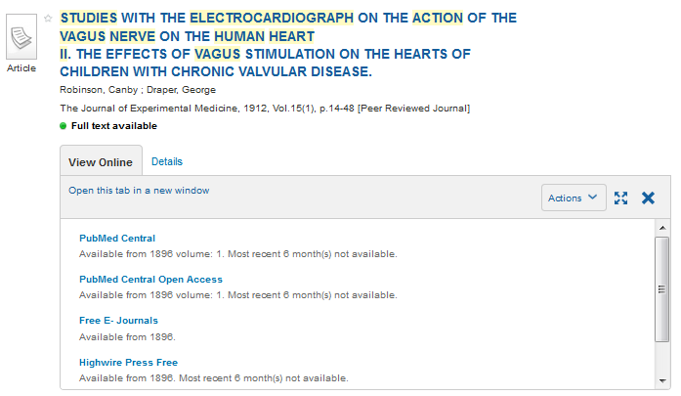
Behind the scenes
It gave us the same “View Online” results for the article as if we had searched Primo Central.
Primo Central is, in a sense, “just another source” like PubMed
The green bullet “Full text available” comes from the Alma holdings file
This is the result when searching Primo Central and it is the same as when searching PubMed and getting the Primo services page

Slide 19
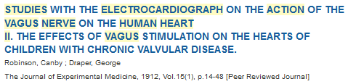
Behind the scenes
When Primo ‘Consulted’ Alma and Alma returned the mash up it was based on the inventory availability, login and the discovery interface display logic rule settings.
The article “Studies with the electrograph …” is from “The Journal of Experimental Medicine” from year 1912”

Slide 20
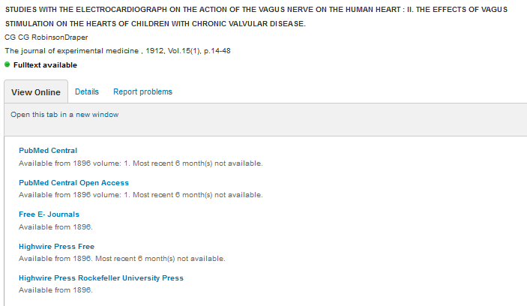
Behind the scenes
The services page presents these five sources to link to the article

Slide 21
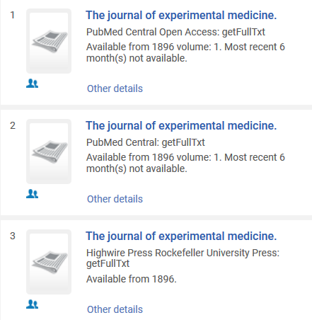
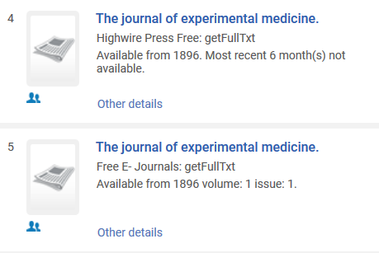
Behind the scenes
These five were presented in Primo and in services pages because if we search Alma for “The Journal of Experimental Medicine” we see that there are the same 5 portfolios which include year 1912

Slide 22
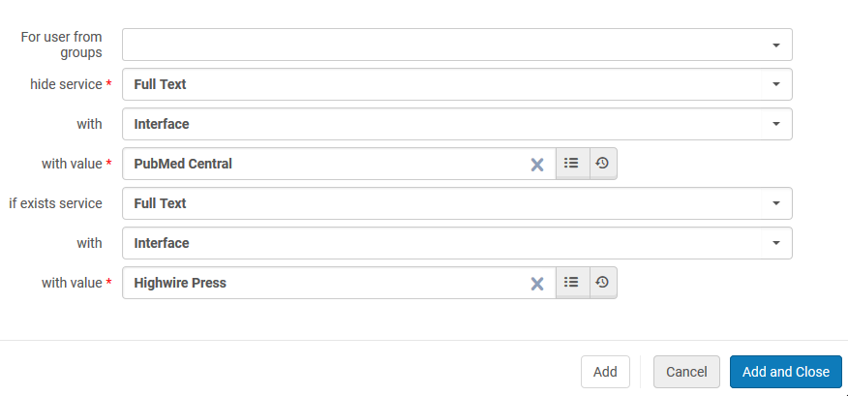
Behind the scenes
If Alma had a discovery interface display logic rule which states (for example):
Hide full text service with interface PubMed Central if exists Full Text with Electronic Collection Highwire Press Rockefeller University Press”

Slide 23
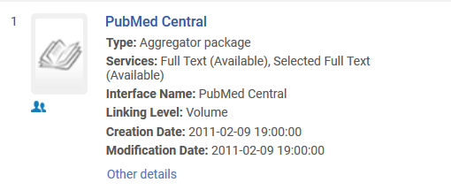
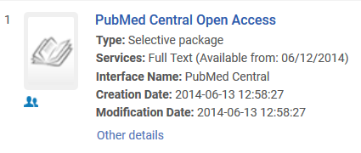
Behind the scenes
Then when coming from Primo Central and when coming from another source we would no longer see ‘PubMed Central’ and ‘PubMed Central Open Access’ because they both have interface ‘PubMed Central’

Slide 24
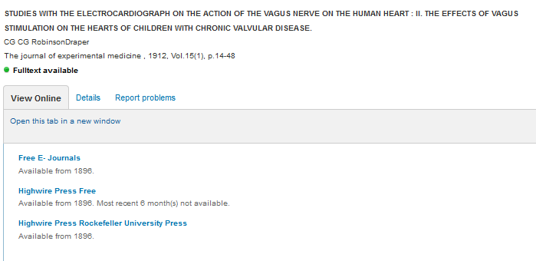
Behind the scenes
Now there are three resources available for accessing full text instead of five
‘PubMed Central’ and ‘PubMed Central Open Access’ no longer appear here

Slide 25
Agenda
Why do we need the Alma Link resolver
Introduction and overview
Example
Behind the scenes
Summary

Slide 26
Summary
  The u resolver can work from Primo or from other database
  It checks via the login if we can access electronic materials
  It checks via the library “holding file” and the CZ (CKB) if the portfolio exists and if so if the library has access and then according to the rules of the general electronic services it presents it.

